Slide 1
UNIT 3-SIMULATED ANNEALING
TE AIDS
PROF.SHILPA GAIKWAD

Slide 2
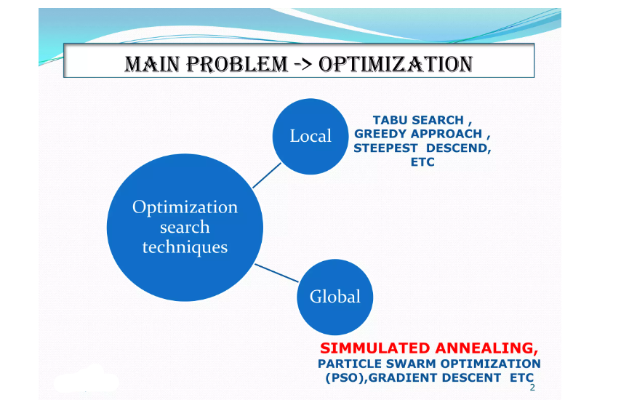
SIMULATED ANNEALING

Slide 3
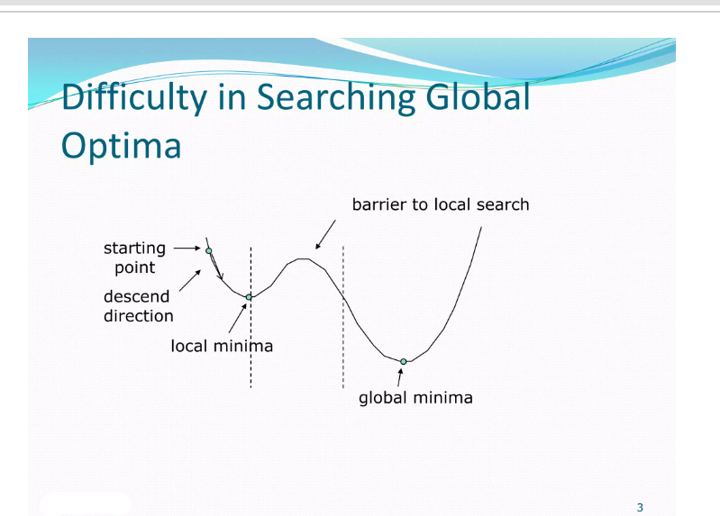
SIMULATED ANNEALING

Slide 4
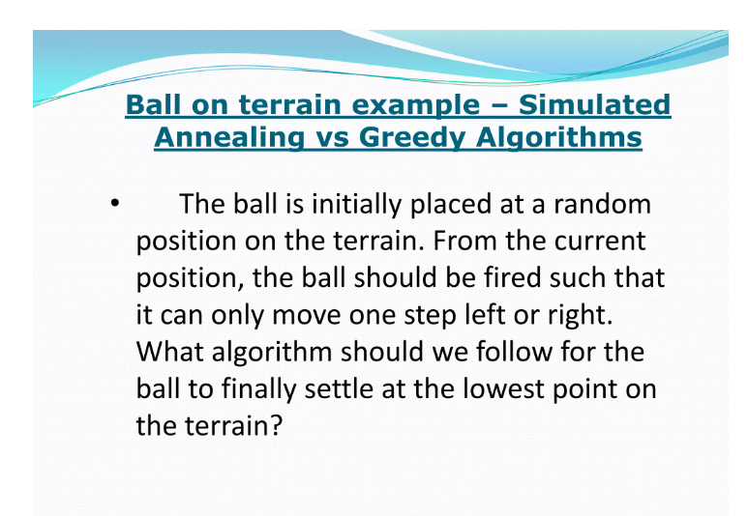
Example of Simulated Annealing

Slide 5
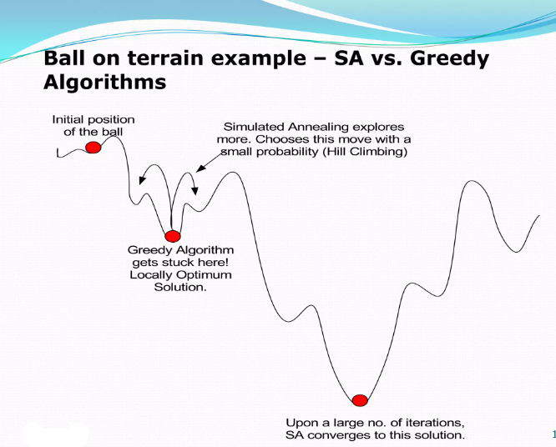
EXAMPLE OF SIMULATED ANNEALING

Slide 6
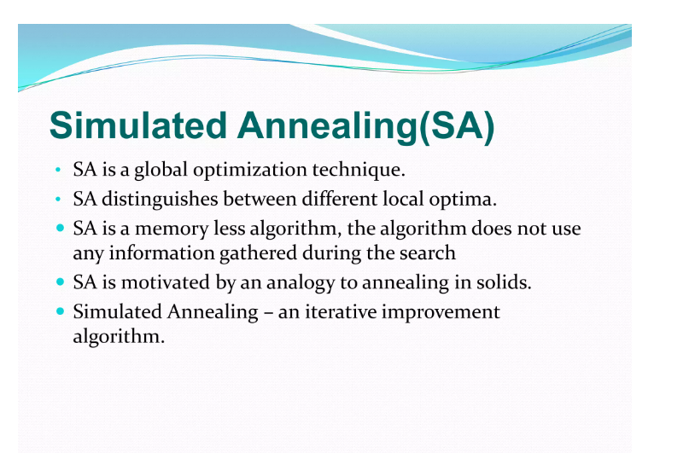
SIMULATED ANNEALING

Slide 7
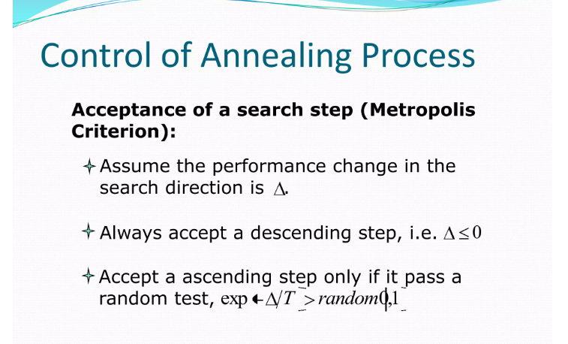
SIMULATED ANNEALING

Slide 8
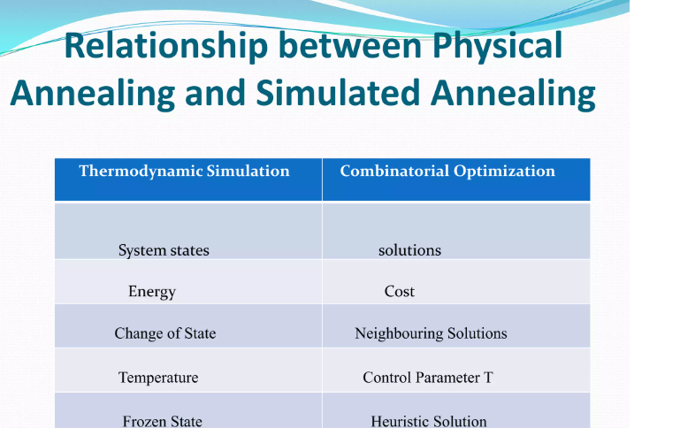
SIMULATED ANNEALING

Slide 9
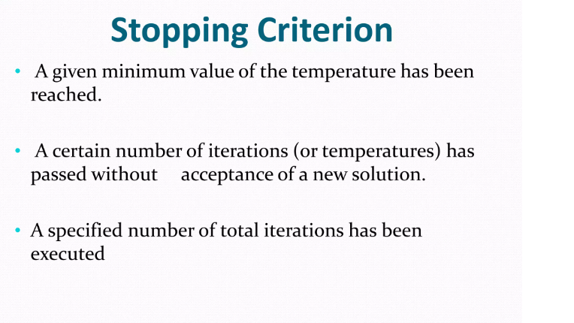
SIMULATED ANNEALING

Slide 10
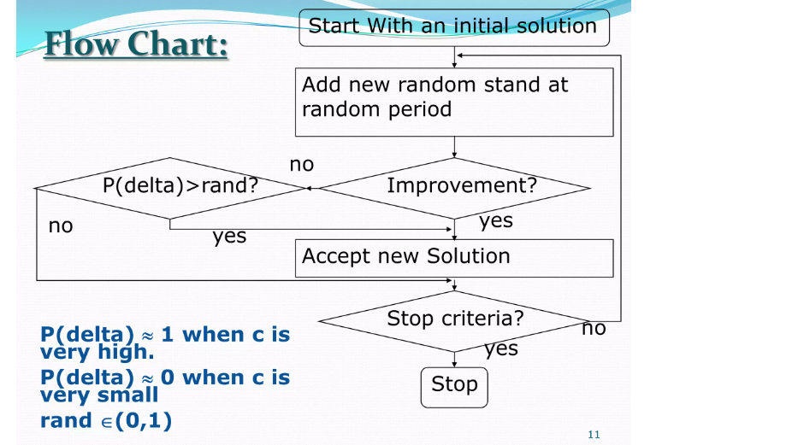
SIMULATED ANNEALING

Slide 11
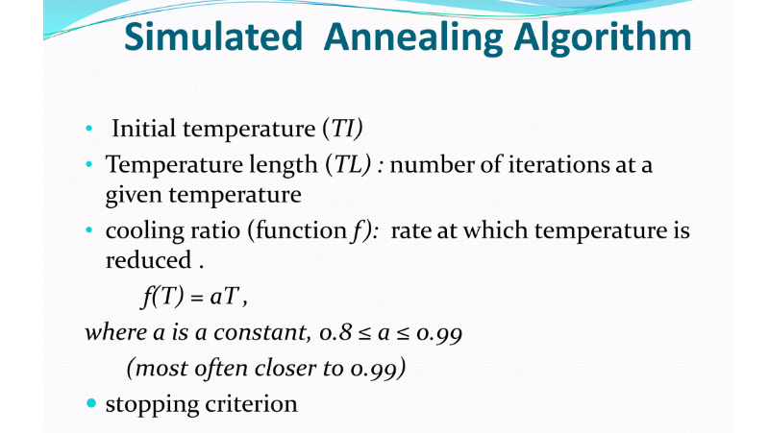
SIMULATED ANNEALING

Slide 12
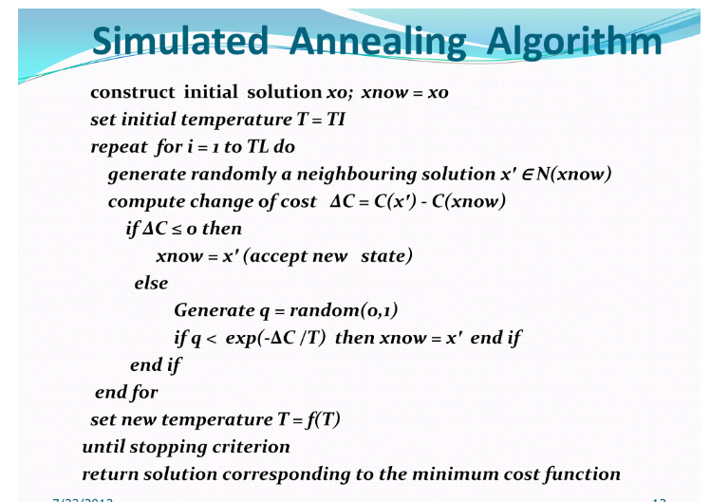
SIMULATED ANNEALING

Slide 13
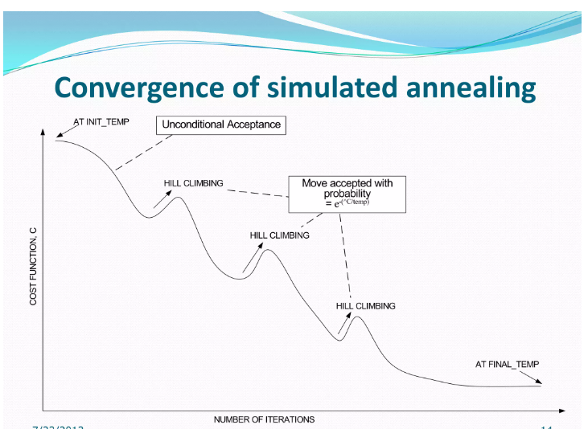
SIMULATED ANNEALING

Slide 14
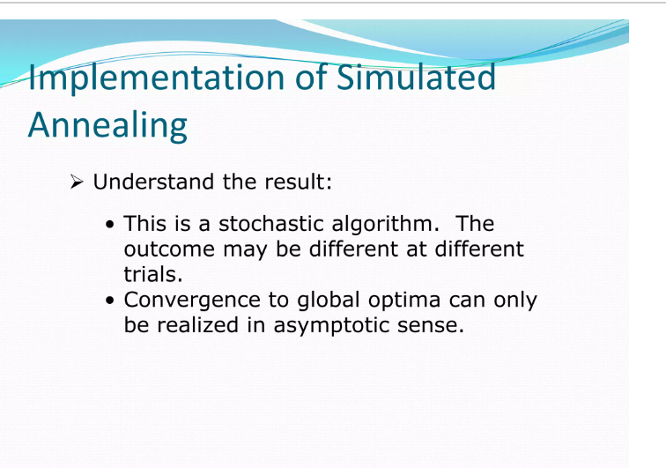
SIMULATED ANNEALING

